Slide 1
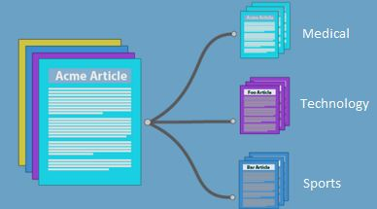
Text categorization
Text categorization (also known as document classification) is a supervised learning task, concerning the assigning of category labels to new documents based on the information learned from a labelled training data (this is a supervised learning problem). Text categorization is a well-studied research area related to information retrieval, machine learning and text mining.

Slide 2
Text categorization
The notion of classification is very general and has many applications within and beyond information retrieval (IR). For instance, in computer vision, a classifier may be used to divide images into classes such as landscape, portrait, and neither. We focus here on examples from information retrieval such as:

Slide 3
Text categorization
The automatic detection of spam pages
Sentiment detection or the automatic classification of a movie or product review as positive or negative. An example application is a user searching for negative reviews before buying a camera to make sure it has no undesirable features or quality problems.
Personal email sorting . A user may have folders like talk announcements, electronic bills, email from family and friends, and so on, and may want a classifier to classify each incoming email and automatically move it to the appropriate folder. It is easier to find messages in sorted folders than in a very large inbox. The most common case of this application is a spam folder that holds all suspected spam messages.
The following figure indicates an example of text classification.

Slide 4
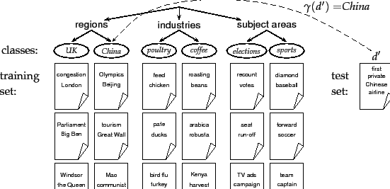
Text categorization

